Slide 1
Job Descriptions That Work
Karen Fraim Goss – Employer Assistance and Resource Network on Disability Inclusion (EARN)
Jonathan Paul Katz – US Department of Labor – Office of Disability Employment Policy (ODEP)
July 26, 2023

Slide 2
Agenda
In this presentation you will learn about:
Writing and maintaining accurate job descriptions, and how these inform applicant decision-making.
Developing job descriptions to be more disability-inclusive.
Using well-written job descriptions to support performance management, provision of effective accommodations, and successful recruitment of applicants with disabilities.
Please hold questions for the end.

Slide 3
What is ODEP?
An agency within the U.S. Department of Labor
The only non-regulatory federal agency that promotes policies and coordinates with employers and all levels of government to increase employment and workplace success for people with disabilities
Mission: To develop and influence policies and practices that increase employment opportunities for people with disabilities

Slide 4
What is the Employer Assistance and Resource Network on Disability Inclusion (EARN)?
EARN offers information and resources to help organizations of all sizes recruit, hire, retain, and advance people with disabilities; build inclusive workplace cultures; and meet diversity, equity, inclusion, and accessibility (DEIA) goals.

Slide 5
Why job descriptions?
Well-crafted job descriptions help support many key human resources objectives including:
Recruiting and hiring qualified employees
Encouraging candidates with disabilities to apply
Hiring inclusively so that candidates with disabilities have equal access at every stage of the hiring process

Slide 6
Why job descriptions? (2)
Helping candidates understand the job requirements
Retaining employees with disabilities, and help with providing accommodations
Ensuring effective performance management practices
Complying with applicable labor laws and collective bargaining agreements

Slide 7
Job descriptions and the ADA
According to the enforcing agency for the ADA, the Equal Employment Opportunity Commission (EEOC):
The ADA does not require an employer to develop or maintain job descriptions.
The ADA does not limit an employer's ability to establish or change the content, nature, or functions of a job.
Complete and thorough job descriptions can help you meet the ADA’s requirements.

Slide 8
Job descriptions and Section 503
Section 503 of the Rehabilitation Act :
forbids federal contractors from discriminating against workers with disabilities
And requires affirmative action to hire people with disabilities and to invite self-identification
Language in job descriptions can constitute (inadvertent!) discrimination by functionally barring or diminishing qualified candidates with disabilities
A well-written job description can help recruit workers with disabilities – and encourage self-identification

Slide 9
Basic elements of a job description
At minimum, a job description should contain the following elements:
Essential job functions, marginal tasks
Knowledge and critical skills
Physical requirements
Environmental factors
Minimal qualifications
Role of ADA and other federal laws

Slide 10
Common issues with job descriptions
Insufficient, actionable job-specific information
Inaccurate job descriptions
Standards may be too stringent
Essential and marginal functions not well defined and delineated - but blurred

Slide 11
Four aspects to create accessible job descriptions
Improving job-candidate fit
Word use
Essential and marginal functions
Qualification standards

Slide 12
Improving job-candidate fit; the challenge
Often the information provided to candidates lack details on:
How the job is performed on a day-to-day basis
What the work environment is like
What workplace flexibilities exist in the workplace
Whether the organization strives to be disability-inclusive

Slide 13
Improving job-candidate fit: the solution
Identify the specific requirements of the position but go beyond this basic information to provide how the job is performed on a daily basis
Offer links to information and employee testimonials about the day-to-day of the job (example on next slide)
Describe the work environment, including where the work is performed, equipment used, and how the candidate would work with others
Provide information about workplace flexibilities such as telework, or flexible schedules, etc.
Include a corporate values statement that explicitly includes disability

Slide 14
Improving job-candidate fit: an example
Transportation Security Administration TSO Realistic Job Preview

Slide 15
Word use: the challenge
Two sometimes conflicting issues: words are too exact – or not exact enough
Words are too specific – specify only one way of performing a job that can be effectively performed in several ways
Words are not exact enough – do not provide the most important activity to effectively perform a task

Slide 16
Word use: the solution
Use plain language
Be explicit on the specific activities and job tasks but avoid specifying a specific way of doing things, especially if they rely on a sense or motion
Provide information on asking for accommodations

Slide 17
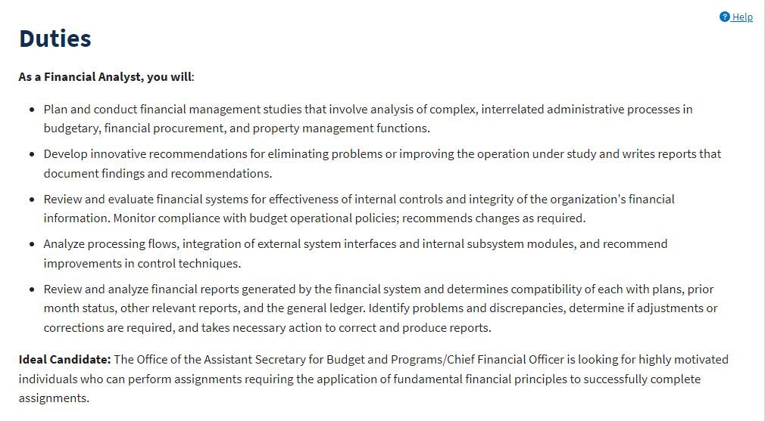
Word use: an example
Department of Transportation Financial Analyst – note the flexibility for method

Slide 18
Essential and marginal functions
The ADA “essential” and “marginal” job functions.
Essential job functions are the basic job duties that an employee must be able to perform, with or without reasonable accommodations.
Other duties are marginal.
Job decisions must be made according to essential job functions.
A candidate must be able to perform the essential functions of the job with or without reasonable accommodation.

Slide 19
What is an essential function?
Consider:
Whether the position exists to perform that function.
The number of other employees available to perform the function or among whom the performance of the function can be distributed.
The degree of expertise or skill required to perform the function.
The employer’s judgment about which functions are essential.

Slide 20
What is an essential function? (2)
Consider:
Prior job descriptions
The amount of time spent performing the function.
The consequences of not requiring the person to perform the function.
The terms of a collective bargaining agreement.
The work experience of others who have had, or currently hold, the same or similar positions

Slide 21
Marginal functions
Marginal functions are incidental to the job
Examples: making copies for a lawyer, moving boxes for a cashier
A marginal function can be reasonably re-assigned
The task must be completed, but another employee can do so
Modification and/or removal of marginal functions can be a reasonable accommodation
Example: a statistician with a hearing disability does not have to answer phone calls from the public

Slide 22
Qualification standards
Under the ADA, people with disabilities are considered qualified if they can perform the essential functions of a position either with or without accommodations.
The ADA and EEOC guidance states that qualification standards need to be “job-related” and consistent with business necessity.
The qualification standard must appropriately represent the requirements of the specific job in question.
If these standards screen out people with disabilities, they must be legitimate for that job.
If the person can meet those standards with an accommodation, they cannot be screened out.

Slide 23
Examples of Essential Functions Requirements – Crane Operator, St. Lawrence Seaway

Slide 24
In summary…
Job descriptions affect who applies and whether they succeed
Descriptions should consider job-candidate fit
Word choice can discourage or present barriers to candidates with disabilities
Essential and marginal functions should be clear
Qualification standards should stem from essential functions

Slide 25
Questions and Comments

Slide 26
Resources
Visit the Employee Assistance and Resource Network on Disability Inclusion (EARN) to learn more.
Job Descriptions web page
Checklist and explainer on inclusive job descriptions
The Job Accommodation Network (JAN) publication on Job Descriptions.
ADA.gov has information about your requirements under the ADA.
Equal Employment Opportunity Commission ADA guidance including information on essential functions.
You can learn more about other ODEP resources from the ODEP website.

Slide 27
Thanks for attending!
Karen Fraim Goss
gosskf@gmail.com
Learn more about EARN on our website.
Jonathan Paul Katz
Katz.Jonathan.P@dol.gov
Learn more about ODEP on the ODEP website.

