Slide 1
Hosting Accessible Virtual Meetings and Presentations
October 28, 2020
Corinne Weible, Co-Director
Partnership on Employment and Accessible Technology (PEAT)

Slide 2
About PEAT
Our Vision
A future where all technologies are born accessible, so that everyone can succeed in their careers.
Our Mission
To foster collaborations that make emerging technologies accessible. To support workplaces in using inclusive technologies that engage the skills of employees with disabilities. To build a future that works.
Who is behind PEAT?
The Partnership on Employment & Accessible Technology (PEAT) is funded by the U.S. Department of Labor's Office of Disability Employment Policy (ODEP).

Slide 3
“Average” Design Fits No One
In 1950, the U.S. Air Force used the average physical measurements of 4,000 pilots to design cockpit specs. But good pilots were frequently having uncontrolled crashes for no clear reason.
It turned out that not a single pilot fit the average specs based on the middle 30% range of the dimensions.
Adding adjustable components reduced crash rates dramatically.

Slide 4
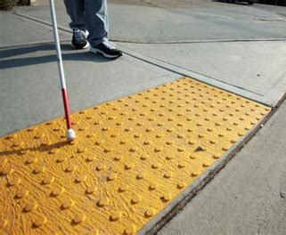
Everyone Benefits from Universal Design
1.3 billion people worldwide have a disability.
Technology created for people with a wide range of abilities also tends to be popular with everyone:
Speech-to-text technologies
Video captioning

Slide 5
What is Accessibility?
Accessibility means that everyone can use the exact same technology as anyone else, regardless of whether:
they can manipulate a mouse
how much vision they have
how many colors they can see
how much they can hear
how they process information

Slide 6
It Pays to Be Inclusive
A 2018 Accenture study found that companies who embrace best practices for employing and supporting more persons with disabilities in their workforce earn 28 percent higher revenue, double the net income, and 30 percent higher economic profit margins than their peers.

Slide 7
Telework & Accessibility

Slide 8
Before and during your presentation

Slide 9
Step 1: Research
Research the accessibility capabilities of online platform you intend to use. Be sure you consider what capabilities you will need for the specific presentation you are planning:
File sharing
Screen sharing
Chat
Whiteboard
Polling/interaction tools
Videos
Multiple speakers
Breakout rooms
If the above features aren’t accessible, consider how you can creatively restructure the meeting without them.

Slide 10
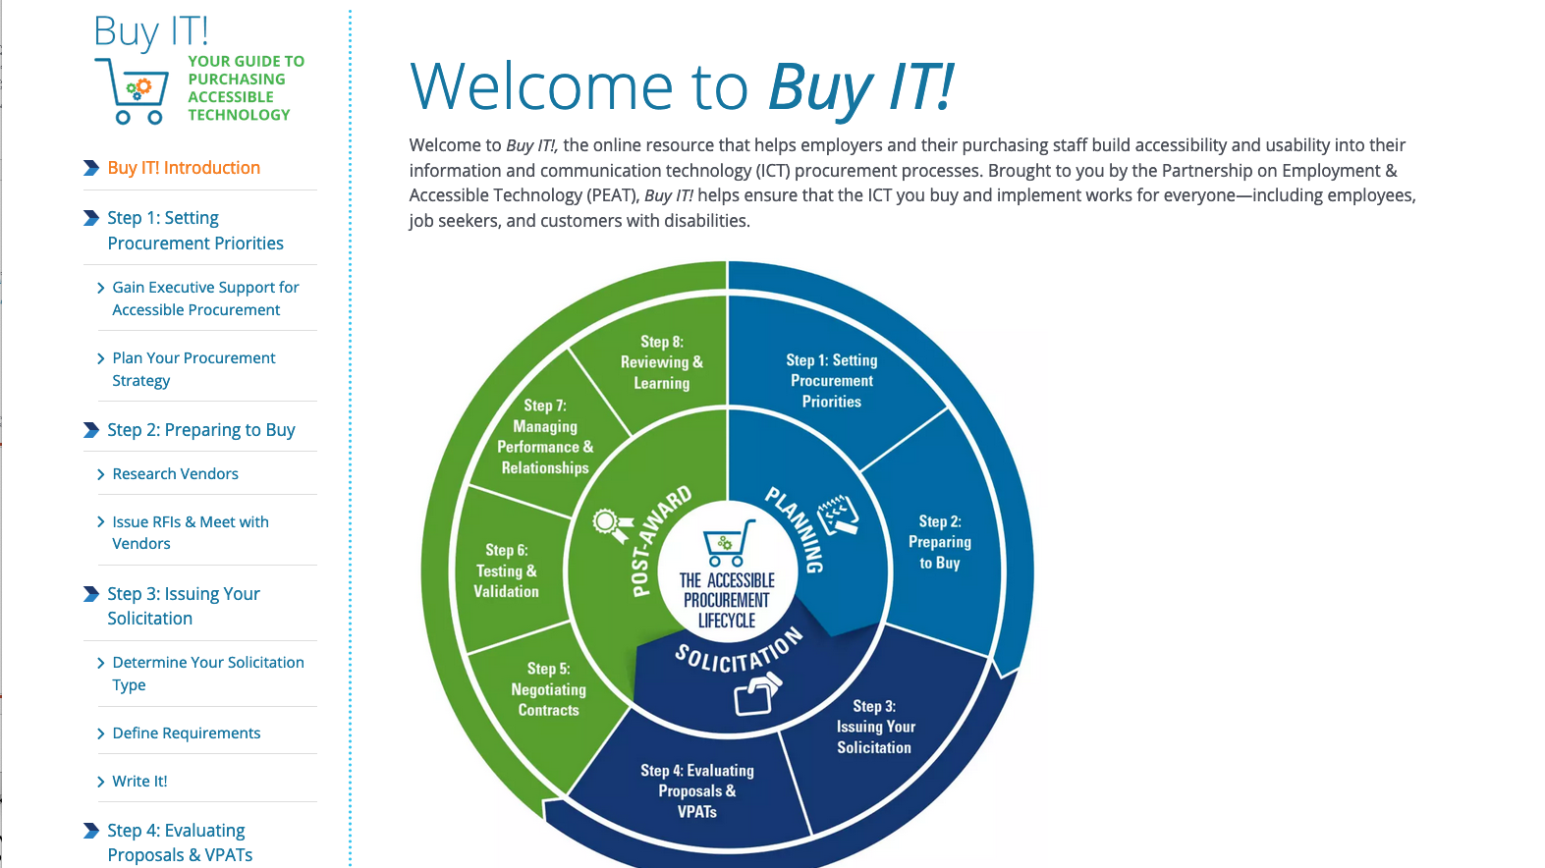
Buy IT: Your Guide to Purchasing Accessible Technology

Slide 11
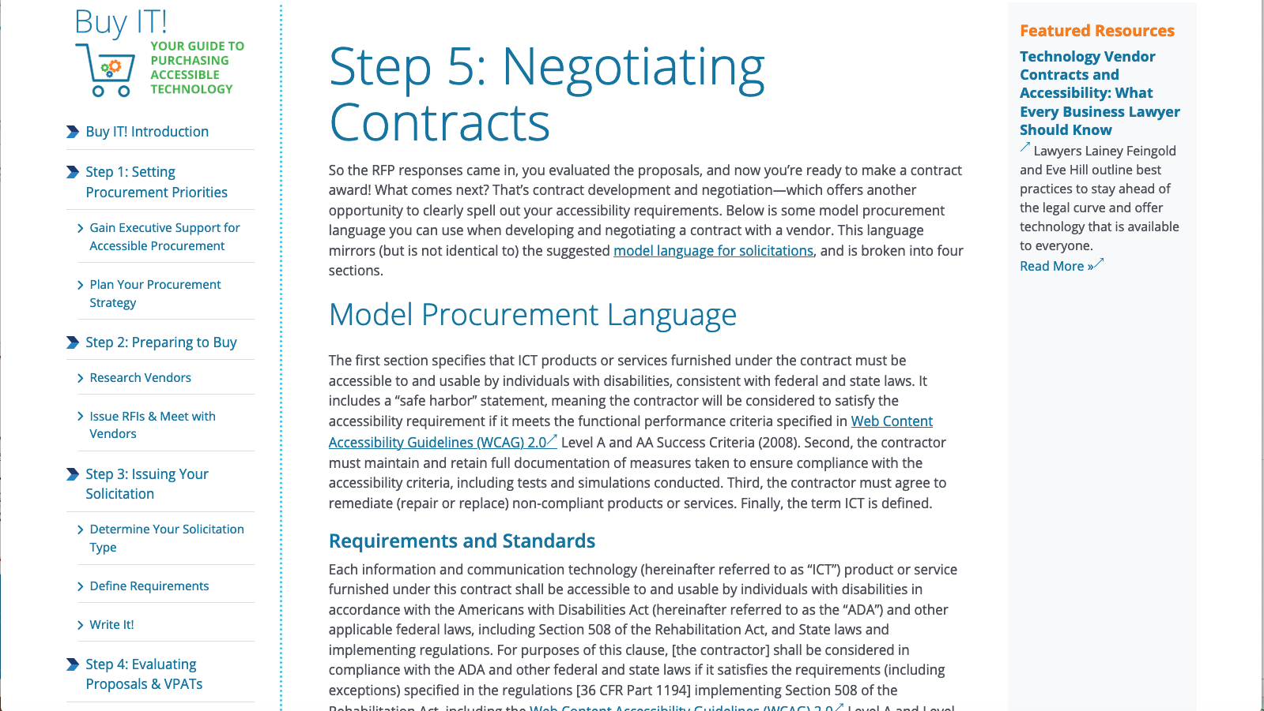
Step 5: Negotiating Contracts

Slide 12
Step 2: Need Sensing
1) The invitation and/or registration form should include the following:
What accommodations you are providing by default
An invitation for participants to share their accommodation needs with the organizer. It’s a good idea to give a deadline of at least 1-2 weeks prior to the meeting in case you need to recruit an interpreter.
2) Set up accounts with vendors for captioning and sign language interpreters so that you can easily contact them when needed.

Slide 13
Provide in all meetings by default
10-digit call-in number for relay access
Meeting materials in an accessible format, provided beforehand
Captions
Live CART is the best option. AI-powered automatic captions are also available (by default in some platforms)
Monitored ways for attendees to be in touch (chat, email, cell)
Long meetings must include regular breaks

Slide 14
Step 3: Put Systems in Place
Before your live event starts, check off these critical to-do items first:
Determine who will play various roles
Confirm that your meeting has a 10-digit call-in number associated with it (not just a URL to join), and that it is available to attendees
Make sure presenters have access to a high-quality mic and webcam
Adjust your platform settings to record your presentation. Though this may not be specifically requested, it’s helpful for everyone to access content after the live event concludes.
Arrange captioning for your presentation in advance (such as through the Federal Relay Service for government employees or another service provider).
Secure sign language interpreters—if requested.

Slide 15
Step 4: Create Accessible Materials
In advance of your presentation, create and share accessible slide decks and other presentation materials with the audience.
PEAT has links to resources for creating accessible presentation materials, including:
How to Make Presentations Accessible to All
PowerPoint Accessibility
Best Practices for Making Word Documents Accessible

Slide 16
Step 5: Prepare Speakers
For a presentation to be fully accessible, speakers must understand how to use key features of the online platform and convey content in a manner that promotes accessibility.
Conduct a dry-run with presenters to verify their familiarity and comfort with the run of show and platform controls (e.g., screen sharing, muting/unmuting audio, etc.).
Remind speakers/meeting leader/chat monitor of meeting rules such as:
One person speaks at a time, all other mics will be muted
Say your name (every time) before speaking
Describe what you are showing/doing on screen, including images and videos
Make it easy to queue speakers

Slide 17
During your presentation

Slide 18
Starting the meeting
Review house keeping and ground rules
Post call-in number, captioning info on opening slide and in chat and read aloud
Re-post any links or attachments sent in invitation
Announce if you are recording
Note any post-meeting information/links

Slide 19
Facilitating the meeting
Mute email/other notifications
Close unrelated apps and content
Watch for alerts from chat monitor
Have chat monitor read aloud items/questions in the chat before answering
When multiple people have asked to speak, announce the order so they can plan ahead
Remember to describe visuals

Slide 20
Manage contributors
Allow time for participants to add notes in the chat or ask to speak
Provide multiple ways to collect feedback
Avoid letting any one person dominate the audio
Recognize that there are many reasons people may not be quick to jump in
Do not require attendees to turn on their cameras

Slide 21
Strategies for ensuring inclusion
Pause at key points: ask if anyone else has something to add
Don’t just take silence as agreement. Some options:
Chat: +1 if agree; a -1 if they disagree
Go through roster of attendees
If one person is dominating, consider asking for other feedback

Slide 22
After your presentation

Slide 23
Step 6: Share Materials
After the event concludes, disseminate a recording of your presentation and the transcript to participants.
This best practice enhances the accessibility of the information you shared and affords people with and without disabilities more opportunities to review and better understand the content you presented.

Slide 24
Step 7: Ask for Feedback
When sharing materials from your presentation, ask participants for feedback on the content of the presentation, its utility, and their experiences with the accessibility of your virtual event.

Slide 25
Resources for Getting Started

Slide 26
Telework & Accessibility Toolkit
Peatworks.org/digital-accessibility-toolkits/telework-and-accessibility/
Learn tips for creating accessible content, including documents, emails, PDFs, social media posts
Checklist for hosting an accessible meeting
Guidance on making a power point accessible
Find resources for hiring accessibility consultants, BYOD policies, staff training, legal guidance, and more

Slide 27
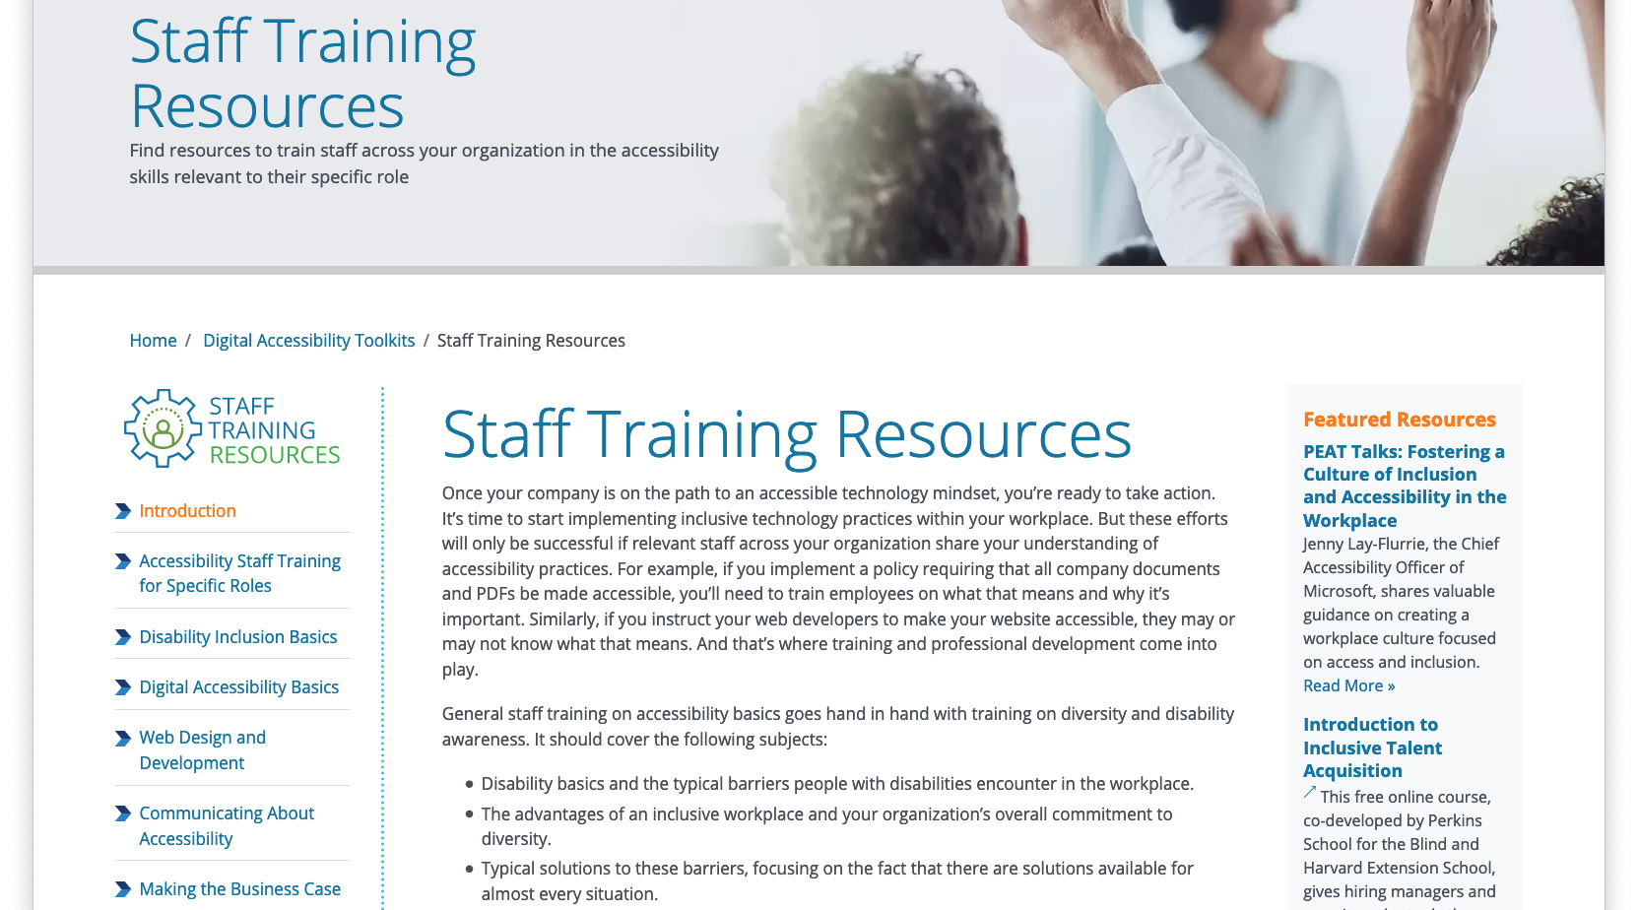
Staff Training Resources

Slide 28
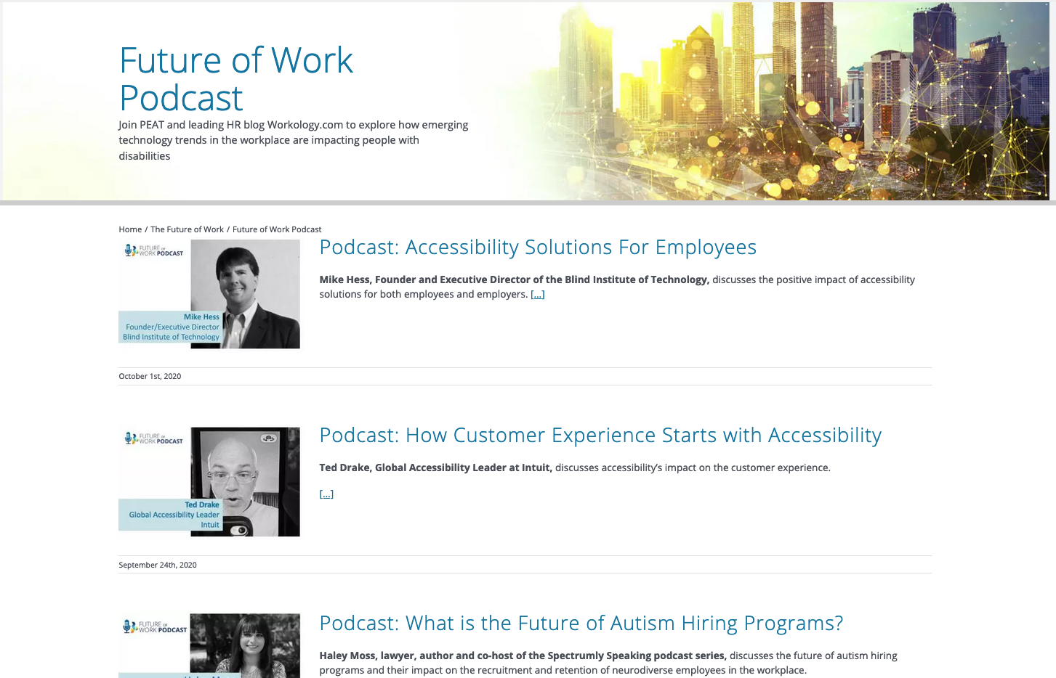
Future of Work Podcast

Slide 29
Digital Accessibility Tips
Use the Accessibility Checker in Microsoft Office
Add well-written alt text to images
Use heading structures in documents, emails, and websites
Avoid sending pdf documents (or include an alternative)
Don’t rely on visual cues like bold text, italics, underlining, and color

Slide 30
Digital Accessibility Tips, continued
Use CamelCase for websites and social media hashtags #BestPractice
Include captions and transcripts for audio/video (including live)
Invite participants to request accommodations prior to an event
Write in plain language
Use informative link text
Good: “Download the report” Bad: ”Click here”

Slide 31
Communicate Your Commitment
Add an Accessibility Statement to your website that includes contact information for reporting technical difficulties.
Celebrate Annual Events like Global Accessibility Awareness Day (third Thursday in May)
If your website is compliant with the Web Content Accessibility Guidelines (WCAG), you can promote your commitment to accessibility by displaying the logo.

Slide 32
Questions?

Slide 33
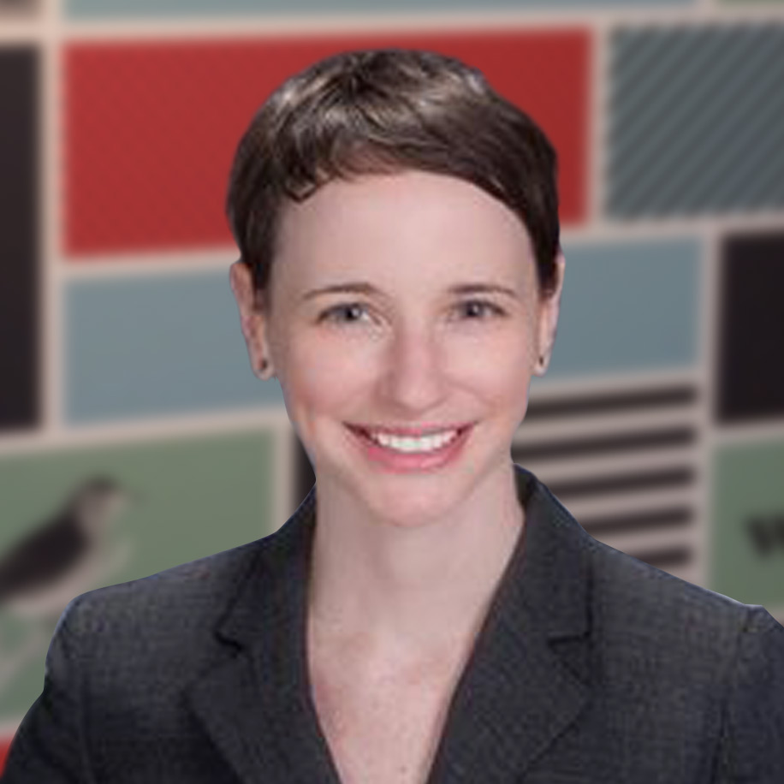
Thank You!
www.PeatWorks.org
@PeatWorks
PeatWorks.org/eNews
info@PeatWorks.org
www.LinkedIn.com/in/Corinne-Weible
Corinne Weible Co-Director Partnership on Employment & Accessible Technology

